Slide 1

















LACTOSE INTOLERANCE
BY
FARHEEN PARVEEN H.SC

Slide 2

INTRODUCTION
Lactose intolerance is a digestive disorder where the body cannot properly digest lactose,a sugar found in milk and dairy products

Slide 3





TYPES OF LACTOSE INTOLERANCE
PRIMARY LACTOSE INTOLERANCE
SECONDARY LACTOSE INTOLERANCE
This is the most common type and occurs when the body gradually reduces its production of lactose after childhood
This type is caused by injury, illness, or surgery that damages the small intestine, where lactose is produced
CONGENITAL LACTOSE INTOLERANCE
DEVELOPMENTAL LACTOSE DEFICIENCY
This is a rare genetic disorder present from birth
Some premature infants may have limited lactase activity initially, but it usually improves as they grow.

Slide 4

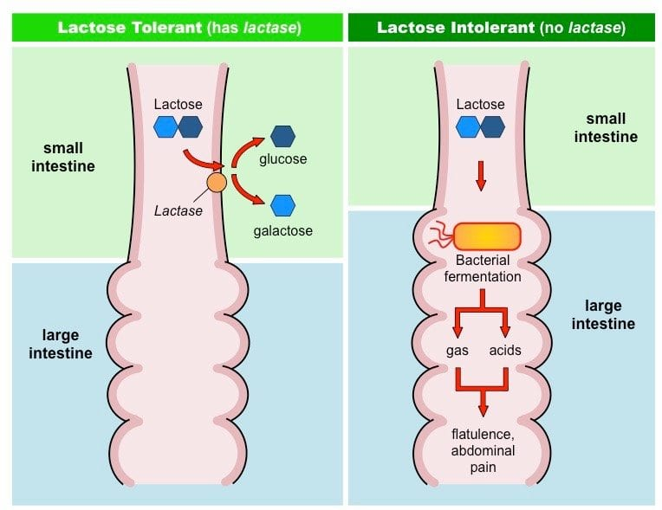

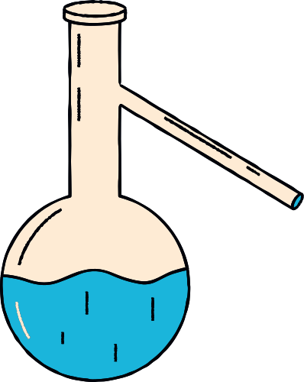

Slide 5





SYMPTOMS

Slide 6

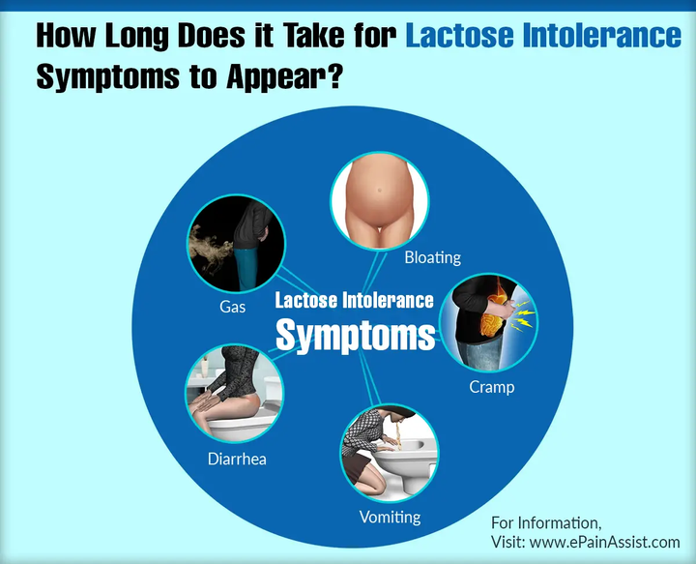
01
GASTROINTESTINAL
  Bloating
  Diarrhea
  Gas
  Abdominal cramps
02
NON-GASTROINTESTINAL
  Headaches
  Fatigue
  joint pain

Slide 7
NUTITIONAL MANAGEMENT

Slide 8

  DIET MODIFICATION
Avoid or limit foods high in lactose, such as milk, cheese, and yogurt.
2. LACTASE SUPPLEMENTS
Lactase enzyme supplements can help some people digest lactose.
3. LACTOSE FREE ALTERNATIVES
Lactose free- dairy products or plant-based alternatives like almond or soy mill can be given

Slide 9
4. GRADUAL INTRODUCTION
Some can tolerate small amount of lactose, so gradual reintroduction of dairy may be possible
5. CALCIUM AND VITAMIN D
Ensure adequate intake of these nutrients through non-dairy sources or supplements.
6. PREBIOTICS AND PROBIOTICS
Both Prebiotics and Probiotics helps in the digestion of lactose in the body

Slide 10

THANK YOU!

