Slide 1
THEORIES OF LEARNING
By Farheen Parveen H.Sc

Slide 2
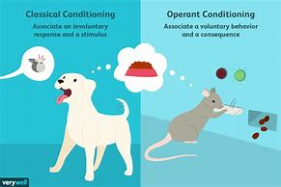
CONTENTS
Classical Conditioning
By Pavlov
Operant Conditioning
By S.F. Skinner

Slide 3
Introduction
Conditioning typically refers to the process of learning and modifying behaviour through repeated experiences or stimuli. It can be categorized into classical conditioning and operant conditioning, two fundamental concepts in psychology.

Slide 4
Classical Conditioning
Classical conditioning, often associated with Ivan Pavlov, involves pairing a neutral stimulus with an unconditioned stimulus to create a conditioned response. For example, ringing a bell before feeding a dog can make the dog associate the bell with food.

Slide 5
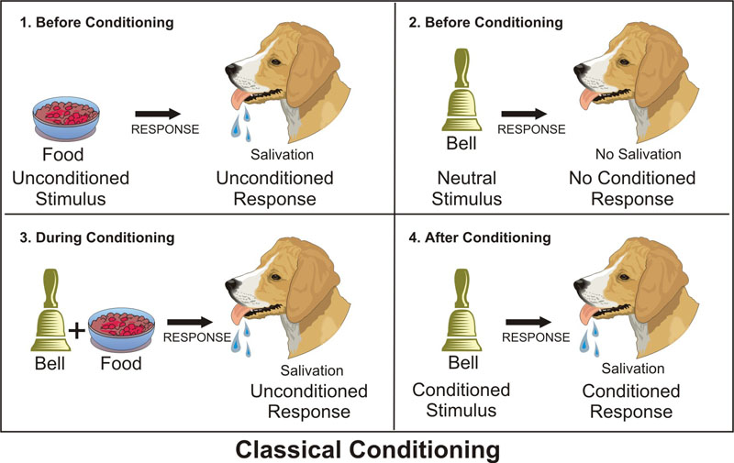

Slide 6
The Main components of classical conditioning are:
Unconditioned Stimulus (US): This is a stimulus that naturally and automatically triggers a specific response without prior learning. For example, in Pavlov's famous experiment with dogs, the presentation of food is the unconditioned stimulus because it naturally causes dogs to salivate.
2. Unconditioned Response (UR): The unconditioned response is the automatic and unlearned reaction that occurs in response to the unconditioned stimulus. In the case of Pavlov's dogs, salivating in response to food is the unconditioned response.

Slide 7
3. Conditioned Stimulus (CS): This is initially a neutral stimulus that, through repeated pairing with the unconditioned stimulus, comes to evoke a response. In Pavlov's experiment, a bell ringing is a neutral stimulus that, when associated with food (the unconditioned stimulus) over time, becomes the conditioned stimulus.
4. Conditioned Response (CR): The conditioned response is the learned reaction that occurs in response to the conditioned stimulus after conditioning has taken place. In Pavlov's experiment, the dogs salivating in response to the bell ringing, after it has been associated with food, is the conditioned response.

Slide 8
Operant Conditioning
Operant conditioning, developed by B.F. Skinner, is a fundamental concept in psychology that revolves around the learning of behaviours through their consequences.

Slide 9
Key Concepts
Reinforcement
Punishment
Punishment is the process of weakening a behaviour by either adding an aversive stimulus (positive punishment) or removing a rewarding stimulus (negative punishment) immediately after the behaviour. Punishment decreases the likelihood of the behaviour being repeated.
Reinforcement is a key concept in operant conditioning. It refers to the process of strengthening a behaviour by either adding a reward (positive reinforcement) or removing an aversive stimulus (negative reinforcement) immediately following the behaviour. Reinforcement increases the likelihood of the behaviour occurring again in the future.

Slide 10
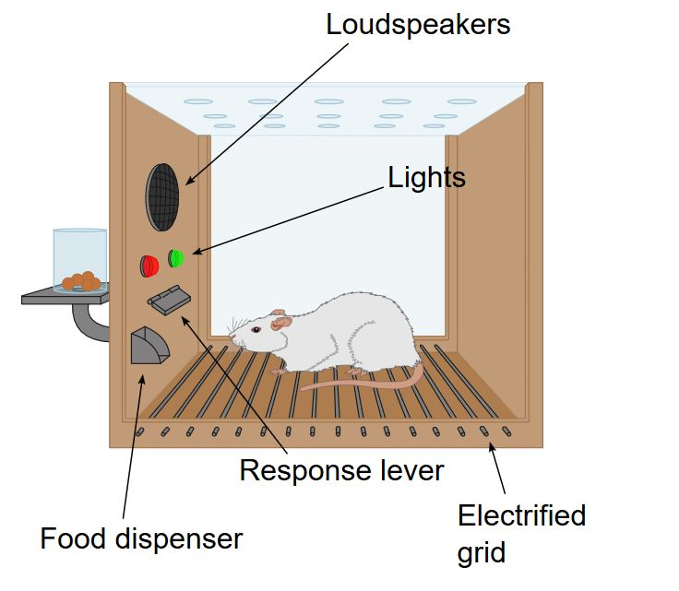
SKINNER BOX

Slide 11
The Skinner box. To show how reinforcement works in a controlled environment, Skinner placed a hungry rat into a box that contained a lever. As the rat scurried around inside the box, it would accidentally press the lever, causing a food pellet to drop into the box. After several such runs, the rat quickly learned that upon entering the box, running straight toward the lever and pressing down meant receiving a tasty snack.
The rat learned how to use a lever to its benefit in an unpleasant situation too: in another box that administered small electric shocks, pressing the lever caused the unpleasant zapping to stop.

Slide 12
Here's how conditioning is applicable in Extension Education
Positive Reinforcement: Extension educators can use positive reinforcement to encourage participation and engagement in educational programs. For example, providing rewards, certificates, or recognition for achieving specific learning goals or attending workshops regularly can motivate learners to continue their education.
Negative Reinforcement: While negative reinforcement is less commonly used in education, it can be applied by removing aversive elements associated with learning. For instance, reducing or eliminating tedious administrative requirements or simplifying the registration process can make it easier for individuals to participate in extension programs.

Slide 13
THANK YOU!

